Slide 1
BEP
1. Introduction, OpenCV

Slide 2
CONTENTS
Introduction of BEP
OpenCV Tutorial
Histogram
Threshold
Assignment

Slide 3
1. Introduction of BEP
BEP : Basic Education Program
Purpose : ∙ Develop programming skills ∙ Especially learn Image processing & Natural Language processing
Programming Language : Python ∙ Can’t use library ∙ You must implement functions

Slide 4
2. OpenCV Tutorial
1) Introduction
Open Source Computer Vision Library
Provide many image processing Algorithms (more than 500!)
Used in various fields. Ex) Robotics, Bigdata, Neural Net and so on
Given material is for reference of basic CV ( DIP01_Lect01.pdf / pw : 201720 ) 출처:영상신호처리 강의, 최두현 교수님 ( CV_week1.pdf ) 출처 : 컴퓨터비전특강, 정희철 교수님

Slide 5
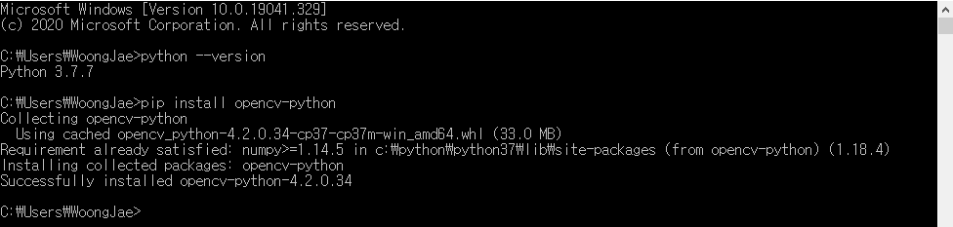
2. OpenCV Tutorial
2) Install
Install Python
Pip install opencv-python (Regardless of OS, using terminal)
Search yourself

Slide 6
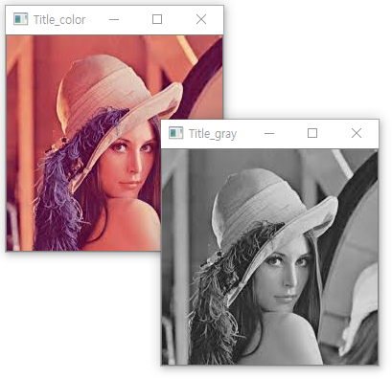
2. OpenCV Tutorial
3) Example Code – Read & Show image
import cv2 as cv
def main():
lena = cv.imread("lena.jpg", cv.IMREAD_COLOR) # Read Img
cv.imshow(“Title_color”, lena) # Show Img
lena_gray = cv.imread(“lena.jpg”, cv.IMREAD_GRAYSCALE)
cv.imshow(“Title_gray”, lena_gray)
if __name__=="__main__":
main()

Slide 7

2. OpenCV Tutorial
3) Example Code – Read pixel value
import cv2 as cv
def main():
lena = cv.imread("lena.jpg", cv.IMREAD_COLOR)
#cv.imshow("Title_color", lena)
print("Size of Img")
print(lena.shape)
print("\nPixel value of (10,10)")
print(lena[10,10])
if __name__=="__main__":
main()
(Output of windows python IDLE)

Slide 8
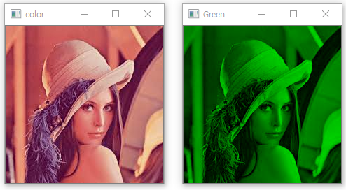
2. OpenCV Tutorial
3) Example Code – Extract Green using Numpy
Install : write pip install numpy on terminal
import cv2 as cv
import numpy as np
def main():
lena = cv.imread("lena.jpg", cv.IMREAD_COLOR)
print("Size of Img : ", lena.shape)
print("Data type of Img : ", lena.dtype)
green = np.zeros((225,225,3), dtype=np.uint8)
for i in range(225):
for j in range(225):
green[i,j,1] = lena[i,j,1]
cv.imshow("color", lena)
cv.imshow("Green", green)
if __name__=="__main__":
main()

Slide 9
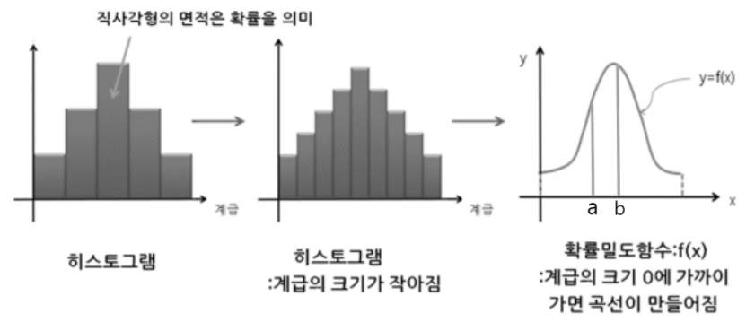
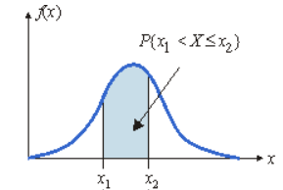
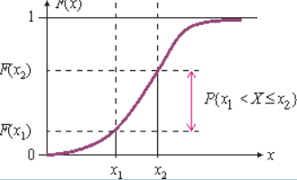
3. Histogram
1) About Histogram
PDF(Probability density function)
CDF(Cumulative distribution function)

Slide 10
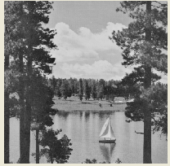
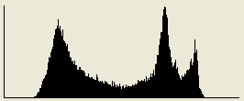

3. Histogram
1) About Histogram
Number of Pixel
Histogram in Image processing :
Expresses the distribution of image’s pixel value
Value of Pixel (0~255)
PDF
CDF

Slide 11
3. Histogram
1) About Histogram
Importance of histogram
Used to know image’s characteristics from a statistical point of view.
Used for feature extraction of images
(Intensity, Frequency, Orientation etc…)
Used in preprocessing for image processing
(Application of histogram, Image binary)
Application of histogram
Sliding, Stretching, Shrink
Equalize
Quantization

Slide 12
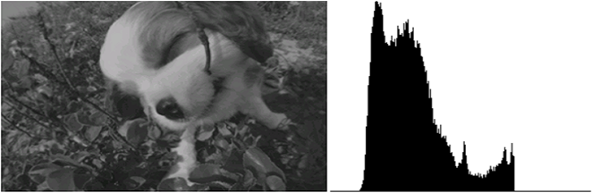
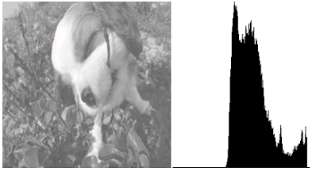
3. Histogram
2) Application of histogram - Sliding
Sliding = [Image value] + offset if sliding < 0, sliding = 0
elif sliding >255, sliding = 255
Slide

Slide 13
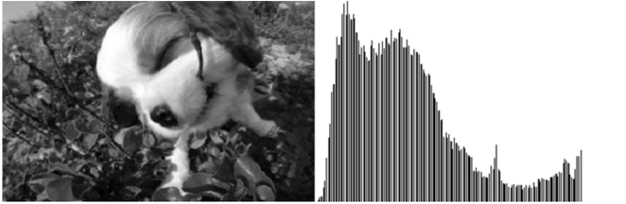
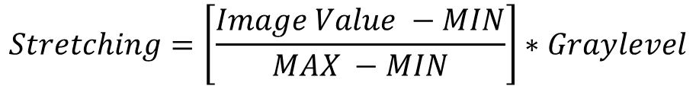
3. Histogram
2) Application of histogram - Stretching
$$Stretching=\left[\frac{Image Value −MIN}{MAX −MIN}\right]∗Graylevel$$
Set the MIN to 0, MAX to 255
Emphasize the Intensity of image
Stretching

Slide 14
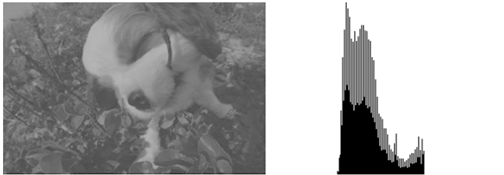
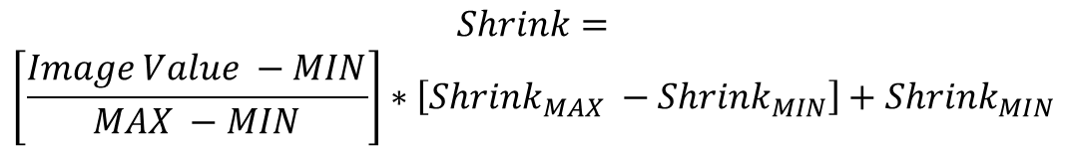
3. Histogram
2) Application of histogram - Shrink
$$Shrink=$$
$$\left[\frac{Image Value −MIN}{MAX −MIN}\right]∗\left[{Shrink}_{MAX} −{Shrink}_{MIN}\right]+{Shrink}_{MIN}$$
Set the MIN to ${Shrink}_{MIN}$, MAX to ${Shrink}_{MAX}$
Shrink MIN
Shrink MAX

Slide 15

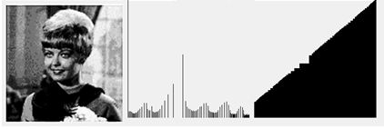
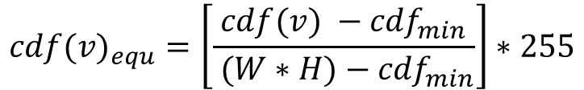
3. Histogram
2) Application of histogram - Equlize
Image
PDF
CDF
Equlize the distribution of histogram -> Increase CDF graph uniformly
Contrast enhancement
Set brightness evenly
$${cdf(v)}_{equ}=\left[\frac{cdf(v) −{cdf}_{min}}{ (W∗H)−{cdf}_{min}}\right]∗255$$
W,H : image size
v : pixel value

Slide 16
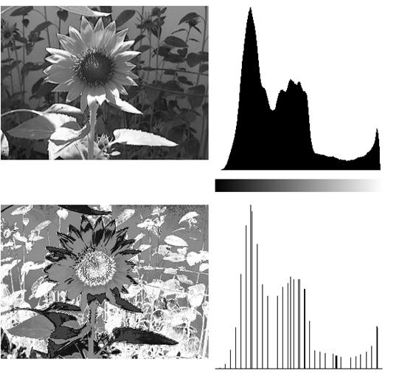
3. Histogram
2) Application of histogram - Quantization
Simplifying to the specific quantized value of histogram distribution
Same concept as signal quantization.
Number of Intensity : 256 (0~255)
Number of Intensity : N
( N < 256 )
Signal

Slide 17
3. Histogram
2) Application of histogram - Quantization
Number of Intensity : 256 (0~255)
If N = 4,
(0 ~ 63) -> 0
(64 ~ 127) -> 64
(128 ~ 191) -> 128
(192 ~ 255) -> 192
There are so many quantization methods.
Number of Intensity : N
( N < 256 )

Slide 18
4. Threshold
1) About Threshold
Advantages of threshold method
Contrast Emphasize
Image Enhancement
Binarization
Create a image composed of only black & white
Static Binarization
Dynamic Binarization

Slide 19

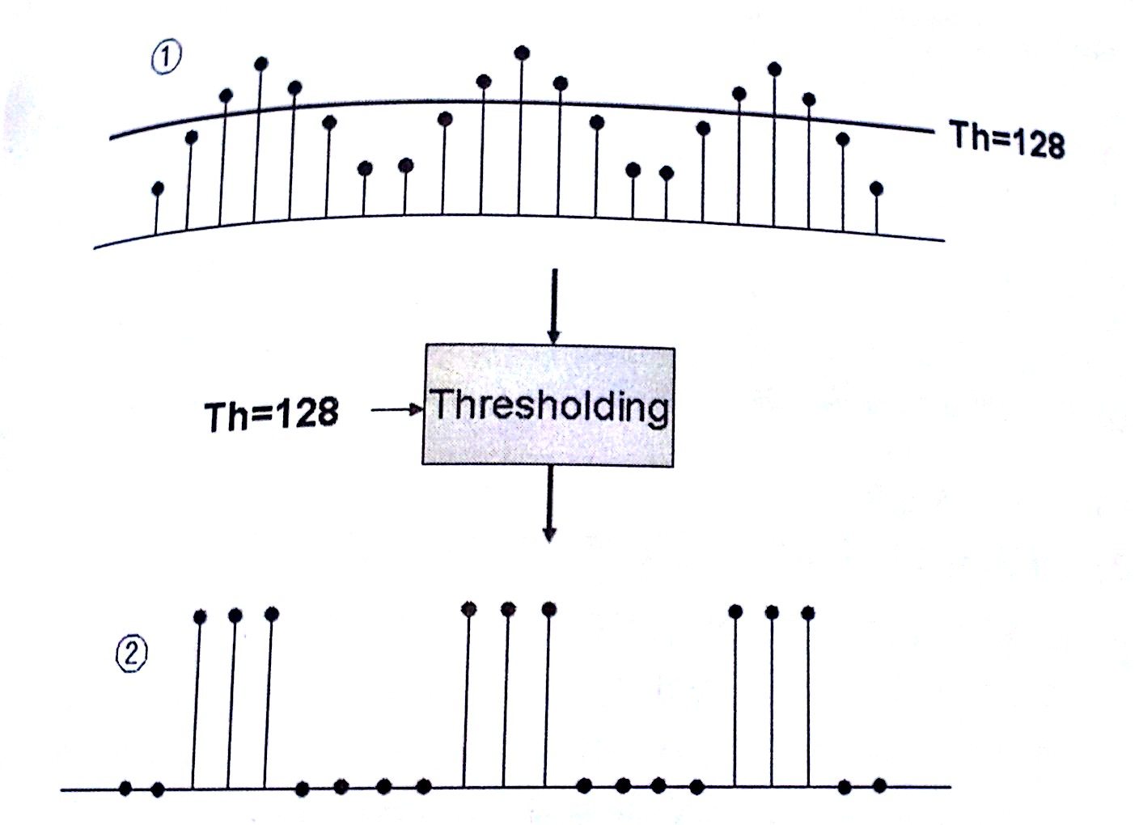
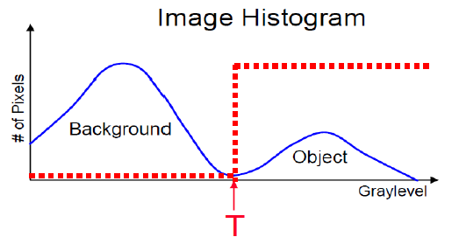
4. Threshold
2) About Binarization
Binary image are also called bi-level or two-level based on threshold point(T). This means that each pixel is stored as a single bit(0 or 1).

Slide 20
4. Threshold
2) Methods of Binarization
Binarization
Static threshold
Dynamic
threshold
Static
- Use fixed Threshold value(T)
Dynamic
- Use variable Threshold value(T)
P-tile
Iterative
Otsu
Valley emphasis

Slide 21
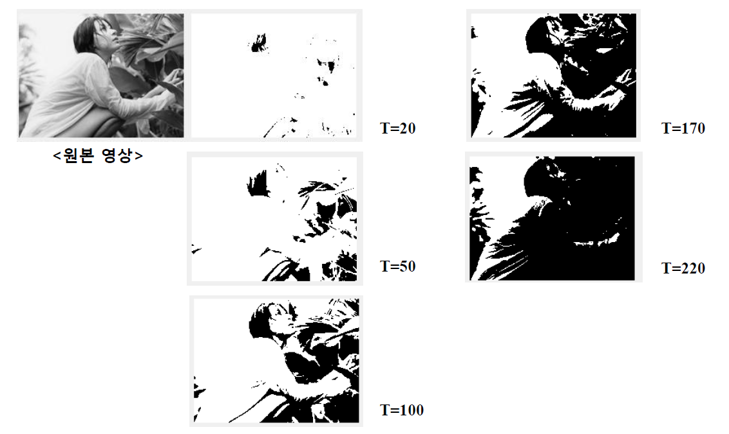
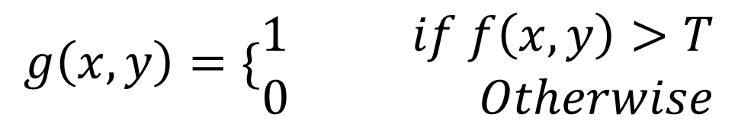
4. Threshold
3) Static Binarization

Slide 22
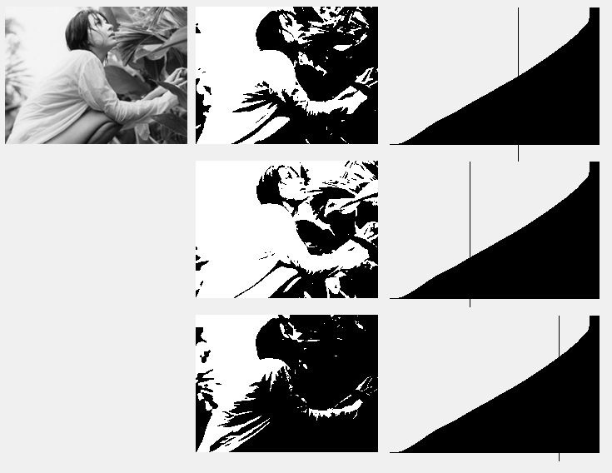
4. Threshold
4) Dynamic ; P-tile binarization
½ (50%)
½ (50%)
The intensity value of the 1/p point of the total pixel of the image is used as the threshold (T).
Use CDF
P = 2
P = 4
P = 1.4

Slide 23
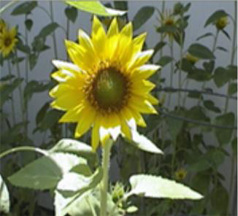
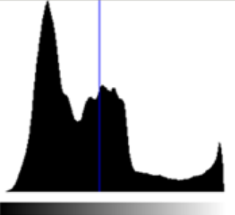
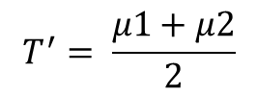


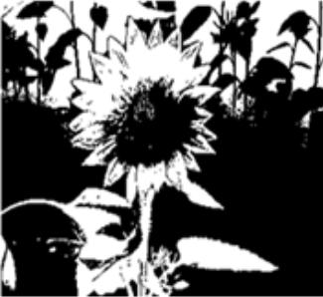
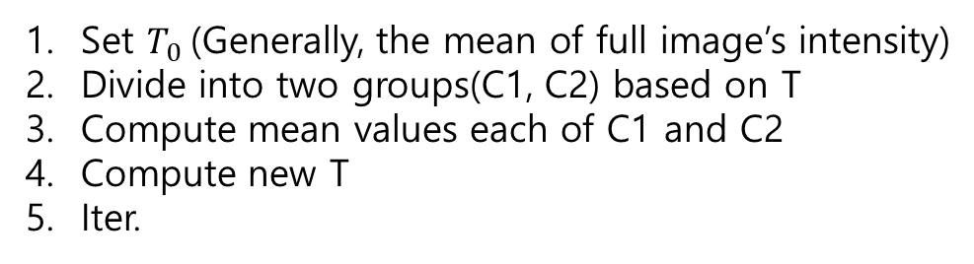
4. Threshold
4) Dynamic ; Iterative binarization
C1
C2
Set $T_{0}$(Generally, the mean of full image’s intensity)
Divide into two groups(C1, C2) based on T
Compute mean values each of C1 and C2
Compute new T
Iter.
T
Until T - T' ≤ specific value
Until specific number of iterative
Result image

Slide 24
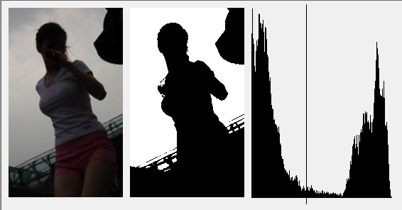
4. Threshold
4) Dynamic ; Otsu binarization
BG
T
Object
BG
Object
Best Binarization : Divide into Background and Object
Otsu algorithm was developed for finding that point

Slide 25
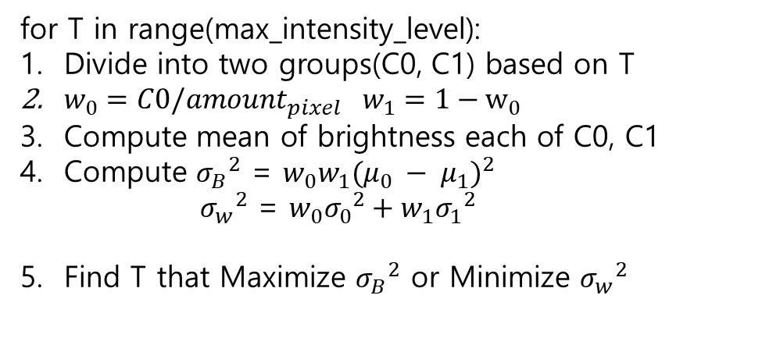
4. Threshold
4) Dynamic ; Otsu binarization
이미지의 Histogram을 배경과 객체 두 개의 Class로 나누어 그 분산들을 이용하여 T값을 선택한다.
Between-class의 분산이 최대가 되는 지점 (between variance)
within class의 분산이 최소가 되는 지점 (within variance)
for T in range(max_intensity_level):
Divide into two groups(C0, C1) based on T
$w_{0}=C0/amount_{pixel}$ $w_{1}=1−w_{0}$
Compute mean of brightness each of C0, C1
Compute ${σ_{B}}^{2}$ = $w_{0}w_{1}{(μ_{0} − μ_{1})}^{2}$ ${σ_{w}}^{2}$ = $w_{0}{σ_{0}}^{2}+w_{1}{σ_{1}}^{2}$
Find T that Maximize ${σ_{B}}^{2}$ or Minimize ${σ_{w}}^{2}$
within
within
Beetween
C0
C1
T

Slide 26
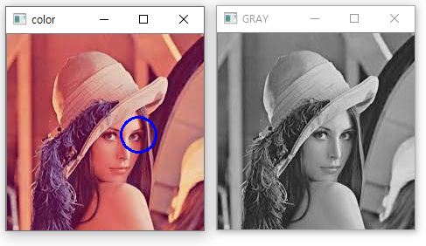
5. Assignment
1) Use OpenCV
Read lena.jpg
Convert gray img *compute gray level yourself
Draw circle like right picture *use cv.circle

Slide 27
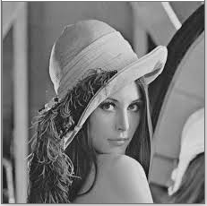

5. Assignment
2) Histogram
Apply Sliding, Stretching and Shrink method to Image * target : gray lena image (maked assign#1) * plot all PDF
Sliding
Stretching
Shrink

Slide 28
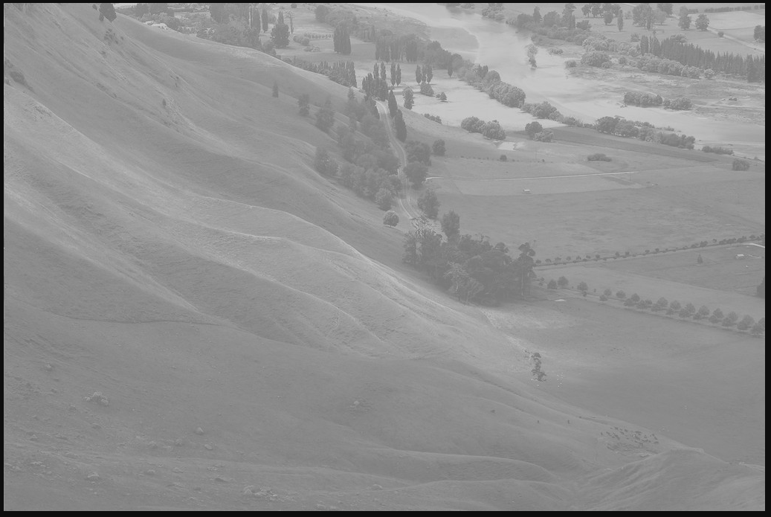
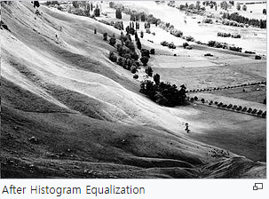
5. Assignment
3) Equalization
Use “Unequal_bay.jpg”
Apply Equalization
Plot CDF before equalize and after equalized

Slide 29
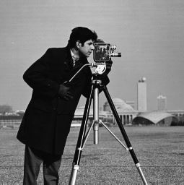
5. Assignment
4) Binarization
Implement a binarization method
Use “Binarization.jpg”
Static (set threshold any number you want)
Dynamic
Iterative, Otsu

